Slide 1
Agricultural Impacts of and Adaptation to Climate Change in the Midwest:
Past and Future
Eugene S. Takle
Professor
Department of Agronomy
Department of Geological and Atmospheric Science
Director, Climate Science Program
Iowa State University
Ames, IA 50011
Symposium on Climate, Water and Ecosystems--Shaping the Great Plains
University of Nebraska – Lincoln
13 October 2011

Slide 2
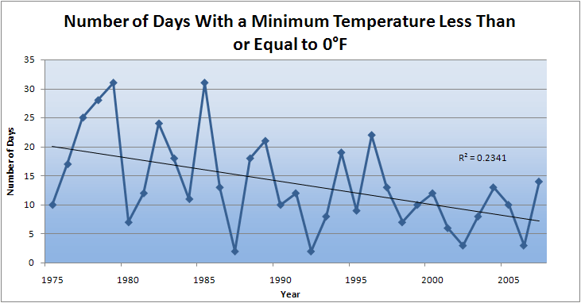
Des Moines Airport Data
Caution: Not corrected for urban heat island effects

Slide 3
First Date Iowa’s Average Fall 4-inch Soil Temperature Was Below 50ºF
Iowa Environmental Mesonet 2010

Slide 4
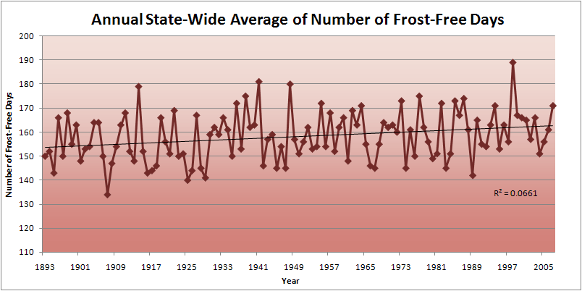
Iowa State-Wide Average Data

Slide 5
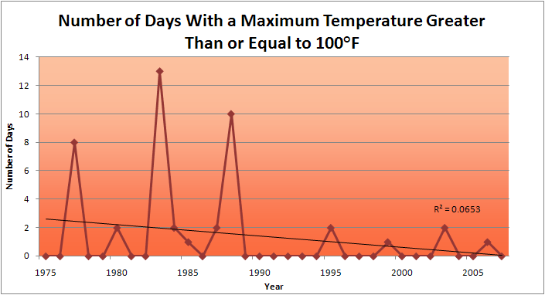
Des Moines Airport Data
1983: 13
1988: 10
1977: 8
2009: 0
2010: 0

Slide 6
Des Moines Airport Data
1983: 13
1988: 10
6 days ≥ 100ºF in the last 22 years
1977: 8
2009: 0
2010: 0

Slide 7
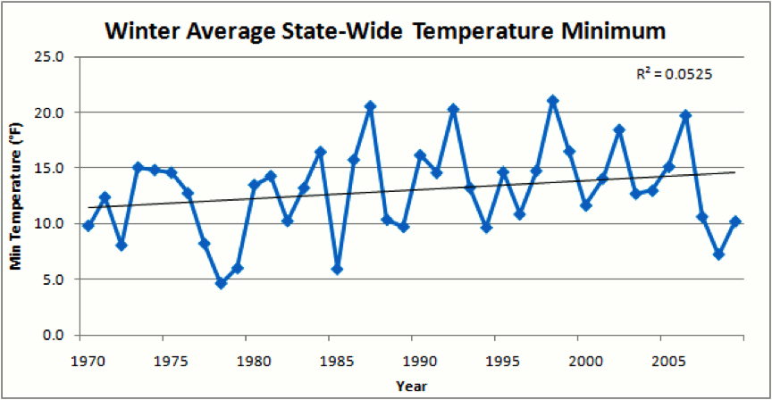
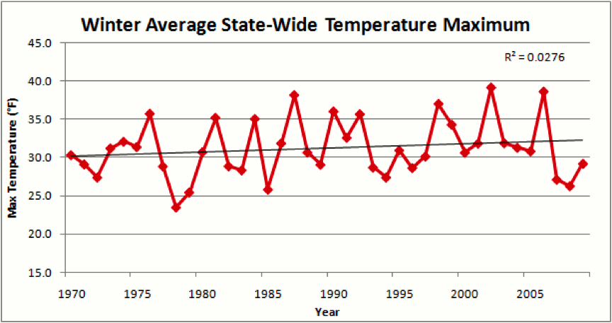
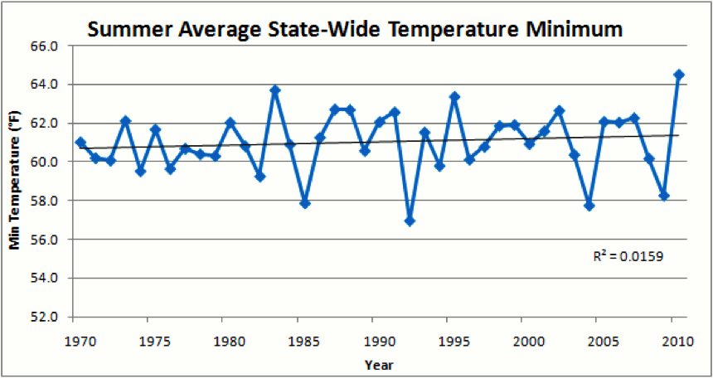
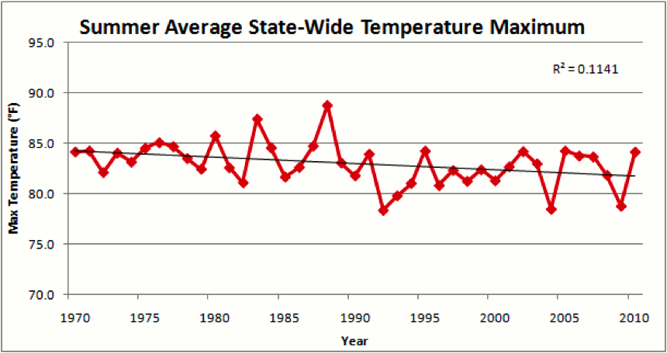

Slide 9
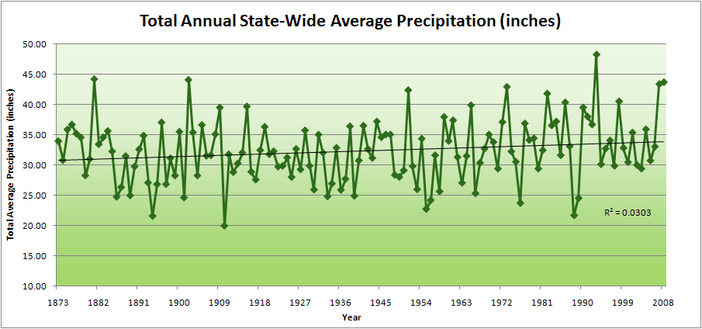
Iowa State-Wide Average Data

Slide 10
Iowa State-Wide Average Data
34.0”
10% increase
30.8”

Slide 11
Iowa State-Wide Average Data
Totals above 40”
8 years
2 years

Slide 12
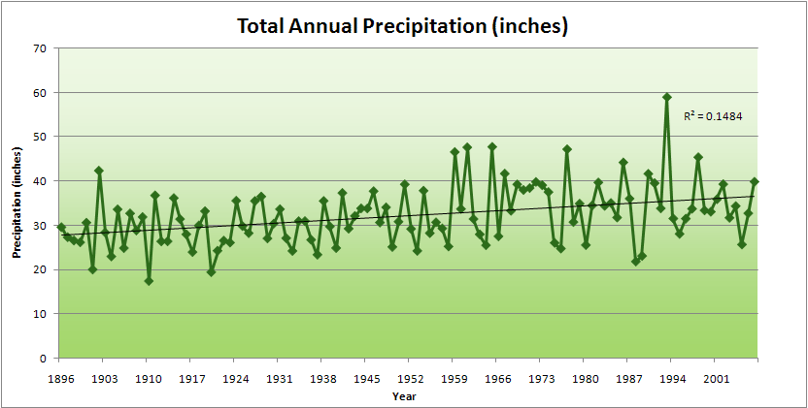
Cedar Rapids Data
Years with more than 40 inches
11
1
28.0”
32% increase
37.0”

Slide 14
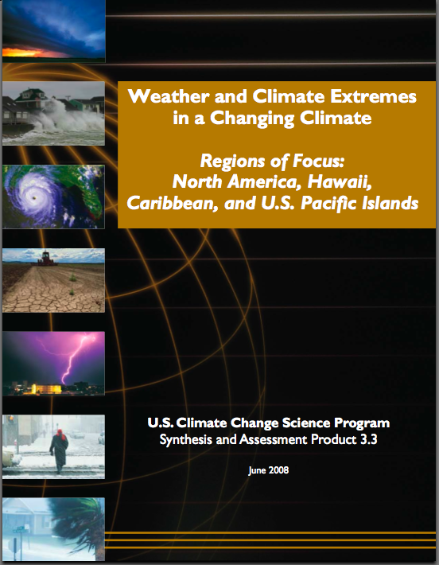
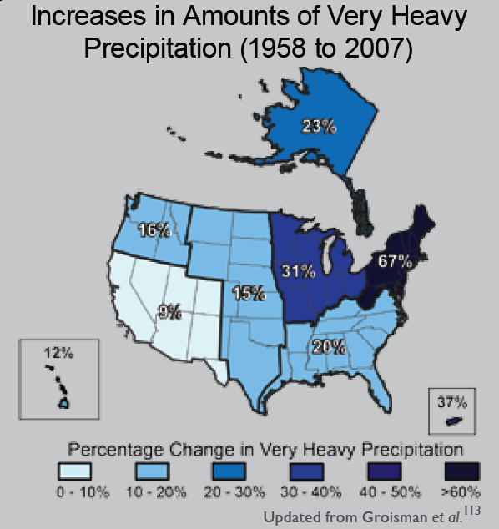
“One of the clearest trends in the United States observational record is an increasing frequency and intensity of heavy precipitation events… Over the last century there was a 50% increase in the frequency of days with precipitation over 101.6 mm (four inches) in the upper midwestern U.S.; this trend is statistically significant “
Karl, T. R., J. M. Melillo, and T. C. Peterson, (eds.), 2009: Global Climate Change Impacts in the United States. Cambridge University Press, 2009, 196pp.

Slide 15
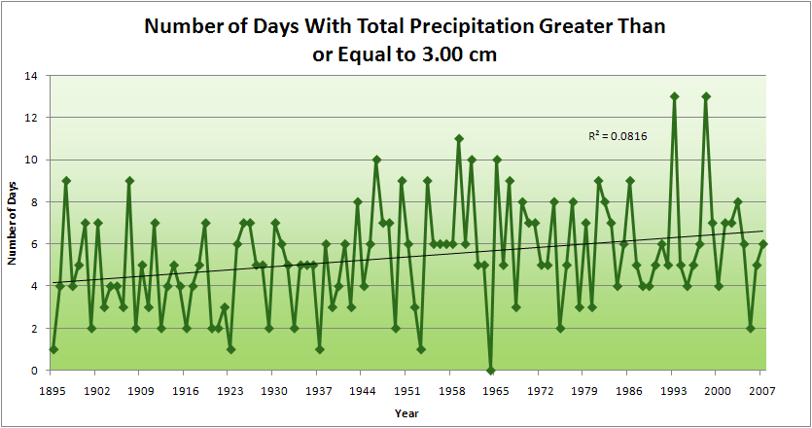
Cedar Rapids Data
1.25 inches
4.2 days
57% increase
6.6 days

Slide 16
Cedar Rapids Data
1.25 inches
Years having more than 8 days
13
2
4.2 days
57% increase
6.6 days

Slide 17
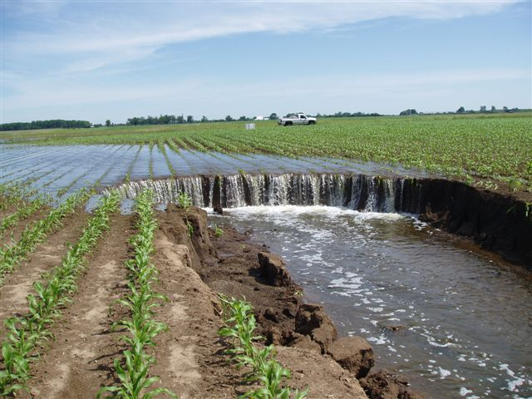
Photo courtesy of RM Cruse

Slide 18
Years with more than 40 inches: 43% Increase
2010 so far

Slide 19
Years having more than 8 days
2010 through Sept 27
7
350% Increase
2
3.7
41% Increase
5.2

Slide 20
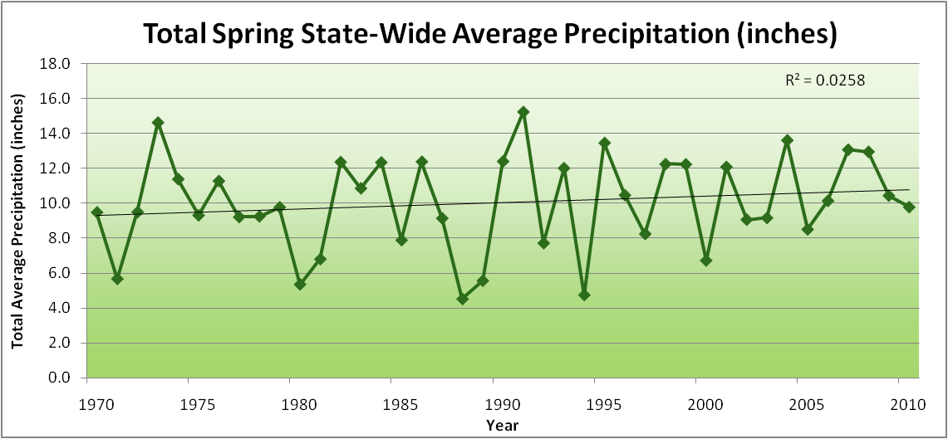
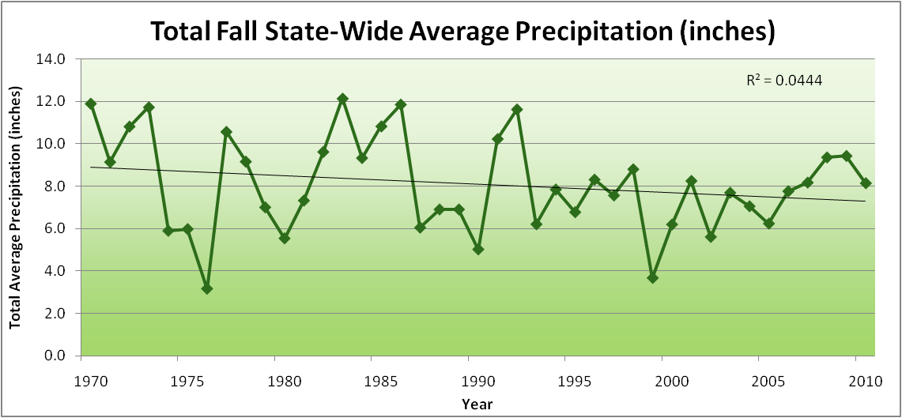
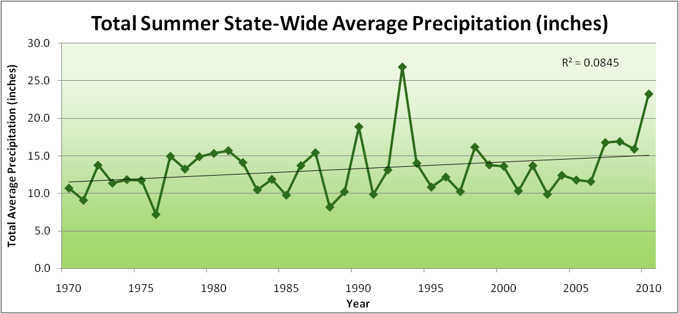
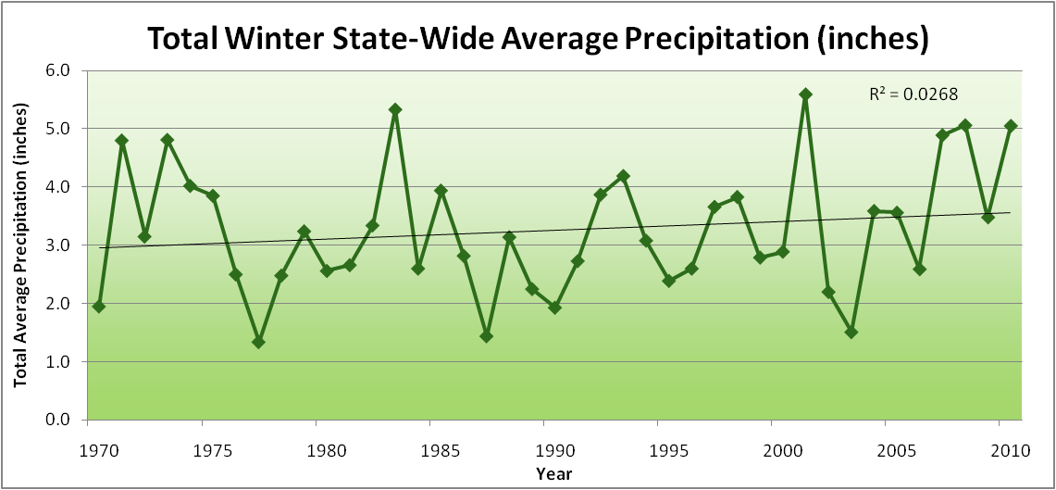
Amplification of the Seasonality of Precipitation
Spring
Fall
21.2 => 25.3 inches (22% increase)
12.1 => 10.5 inches (13% decrease)
Summer
Winter

Slide 21
Amplification of the Seasonality of Precipitation
Spring
Fall
21.2 => 25.3 inches (22% increase)
12.1 => 10.5 inches (13% decrease)
Summer
Winter

Slide 22
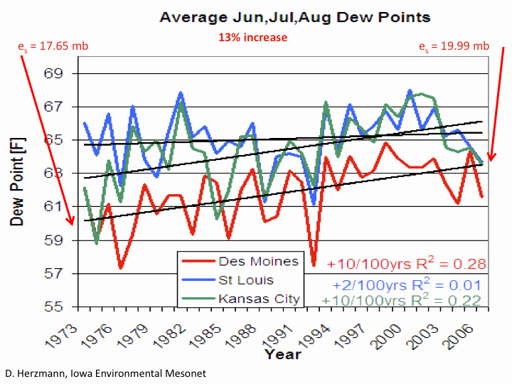

Slide 23
Iowa Agricultural Producers are Adapting to Climate Change:
Longer growing season: plant earlier, plant longer season hybrids, harvest later
Wetter springs: larger machinery enables planting in smaller weather windows
More summer precipitation: higher planting densities for higher yields
Wetter springs and summers: more subsurface drainage tile is being installed, closer spacing, sloped surfaces
Fewer extreme heat events: higher planting densities, fewer pollination failures
Higher humidity: more spraying for pathogens favored by moist conditions. more problems with fall crop dry-down, wider bean heads for faster harvest due to shorter harvest period during the daytime.
Drier autumns: delay harvest to take advantage of natural dry-down conditions, thereby reducing fuel costs
HIGHER YIELDS!!
Is it genetics or climate? Likely some of each.

Slide 24
Visioning Future Climate Change for Iowa

Slide 25
Visioning Future Climate Change for Iowa
You are here

Slide 26
Visioning Future Climate Change for Iowa
You are here
Today

Slide 27
Visioning Future Climate Change for Iowa
You are here
Today
Past

Slide 28
Visioning Future Climate Change for Iowa
You are here
Today
Past
Future

Slide 29
Visioning Future Climate Change for Iowa
You are here
?
Today
Past
Future

Slide 30
You be the scientist: For which hypothesis of the future can you find the most evidence?
?
Some Climate Variable (temp, precip, humid)
Today
Past
Future

Slide 31
You be the scientist: For which hypothesis of the future can you find the most evidence?
Some Climate Variable (temp, precip, humid)
Measured past
Today
Past
Future

Slide 32
You be the scientist: For which hypothesis of the future can you find the most evidence?
Some Climate Variable (temp, precip, humid)
Future will return to something in the past
Measured past
Today
Past
Future

Slide 33
You be the scientist: For which hypothesis of the future can you find the most evidence?
Future will be like average of the past
Some Climate Variable (temp, precip, humid)
Future will return to something in the past
Measured past
Today
Past
Future

Slide 34
You be the scientist: For which hypothesis of the future can you find the most evidence?
Future will be like today
Future will be like average of the past
Some Climate Variable (temp, precip, humid)
Future will return to something in the past
Measured past
Today
Past
Future

Slide 35
You be the scientist: For which hypothesis of the future can you find the most evidence?
Current trend will continue
Future will be like today
Future will be like average of the past
Some Climate Variable (temp, precip, humid)
Future will return to something in the past
Measured past
Today
Past
Future

Slide 36
You be the scientist: For which hypothesis of the future can you find the most evidence?
What does the best available science have to say?
Current trend will continue
Future will be like today
Future will be like average of the past
Some Climate Variable (temp, precip, humid)
Future will return to something in the past
Measured past
Today
Past
Future

Slide 37
You be the scientist: For which hypothesis of the future can you find the most evidence?
Based on climate models, climate scientists overwhelmingly agree that the future will be more extreme than today
Current trend will continue
Future will be like today
Future will be like average of the past
Some Climate Variable (temp, precip, humid)
Future will return to something in the past
Measured past
Today
Past
Future

Slide 38
You be the scientist: For which hypothesis of the future can you find the most evidence?
Future will be more extreme than today
Current trend will continue
Future will be like today
Future will be like average of the past
Some Climate Variable (temp, precip, humid)
Future will return to something in the past
Measured past
Today
Past
Future

Slide 39
You be the scientist: For which hypothesis of the future can you find the most evidence?
Some Climate Variable (temp, precip, humid)
Measured past
Today
Past
Future

Slide 40
My Opinion
A Prudent View of the Future
Some Climate Variable (temp, precip, humid)
Measured past
Today
Past
Future

Slide 41
Future Challenges to Adaptation in the US Midwest (near term):
Wetter spring and early summer:
    Continued challenges to early field work
    More soil compaction
    Delayed planting
More frequent and higher-intensity extreme rain events:
    Water-logged soils
    Lack of oxygen to roots
    More ponding (rural roads are becoming levees)
    Additional installation of subsurface tile drainage is inundating downstream urban areas
    Loss of nitrogen
Higher daily average temperatures (due to higher night-time temperatures):
    Differential acceleration of reproductive processes: pollination failure
    During grain-filling periods leads to higher nighttime respiration and reduced grain weight
    Loss of soil carbon
Increased humidity:
    More pressure from pests and pathogens
    Multiple stressors

Slide 42
Future Challenges to Adaptation in the US Midwest (long-term, occasional short-term):
Drought pattern from the west or south occasionally spills into Midwest:
    Underlying warming of the last 40 years caused by rise in CO₂ that has been buffered by high evaporative and transpiration cooling is unmasked
    High plant populations not sustainable on reduced moisture
    Prairie fires
    Wind erosion of soils
Overwintering of pests and pathogens formerly not able to survive extreme cold temperatures

Slide 43
Climate trends of the recent past have low statistical significance. Nevertheless, they have forced significant adaptation for Iowa farmers and communities:

Slide 44
Climate trends of the recent past have low statistical significance. Nevertheless, they have forced significant adaptation for Iowa farmers and communities:
Even climate trends of low statistical significance can have impacts of high significance to Iowa agriculture and communities

Slide 45
Sustaining agricultural production without depleting natural resources will become increasingly difficulty with increasing levels of climate change

Slide 46
For More Information
Contact me directly:
gstakle@iastate.edu
Current research on regional climate and climate change is being conducted at Iowa State University under the Regional Climate Modeling Laboratory
http://rcmlab.agron.iastate.edu/
North American Regional Climate Change Assessment Program
http://www.narccap.ucar.edu/
Climate Science Program website:
http://climate.engineering.iastate.edu/
Or just Google Eugene Takle

